Slide 1
LEVERAGING ROUTINE DATA FOR MALARIA CONTROL IN RWANDA, THROUGH DATA SCIENCE AND MATHEMATICAL MODELLING
PhD Student: Noella Bigirimana
First Supervisors: Dr. Monica Golumbeanu
Prof. Dr. Manuel Hetzel
Second Supervisor: PD Dr. Christian Nsanzabana Additional Expert: Dr. Emilie Pothin
Reviewers: Dr. Aita Signorell Dr. Ottavia Prunas
Statistics Review: Dr. Amanda Ross

Slide 2
Background training
Education
Sep 2023 - Ongoing PhD Candidate, Epidemiology
Swiss Tropical & Public Health Institute/ University of Basel, Switzerland
2014 - 2015 MSc, Masters in International Health Policy & Management
Brandeis University , Massachusetts, United States
2009 - 2012 BSc, Human Biology, Health & Society
Cornell University, New York, United States
Recent Work Experience
Jan 2022 - Present Deputy Director General
Rwanda Biomedical Centre, Kigali, Rwanda
Dec 2020 - Jan 2022 Division Manager | Research, Innovation & Data Science
Rwanda Biomedical Centre, Kigali, Rwanda

Slide 3
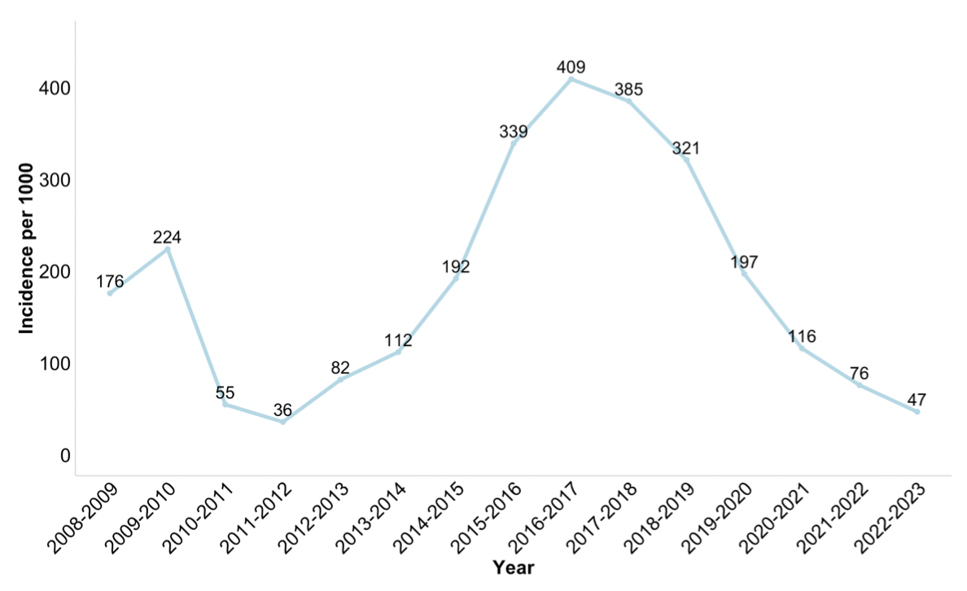
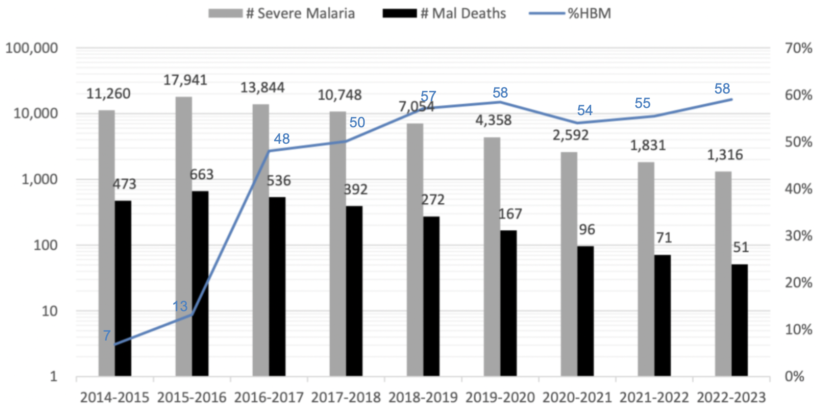
Malaria incidence in Rwanda has been significantly decreasing since 2017
Trends in Malaria Incidence (per 1000 individual) 2008-2023
Trends in Severe Malaria Cases, Deaths and HBM 2014-2023
Data from RBC/MOPDD
Data from RBC/MOPDD
Significant upsurge in malaria cases (LLINs issues, insecticide (pyrethroid) resistance, vector behavior change, increased case detection, climate variations)
A malaria contingency plan was deployed in 2016
Notes:
Diagnosis: All suspected malaria cases receive testing : CHWs using RDTs (55-60%) & HF: 40-45%

Slide 4
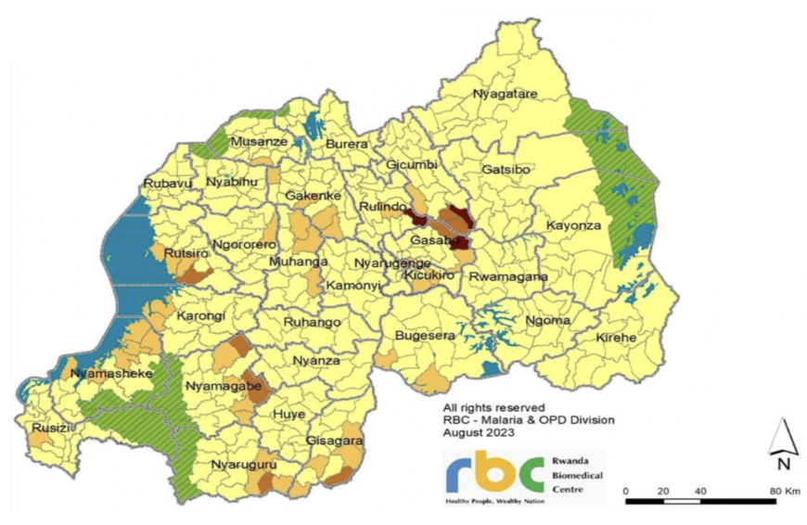
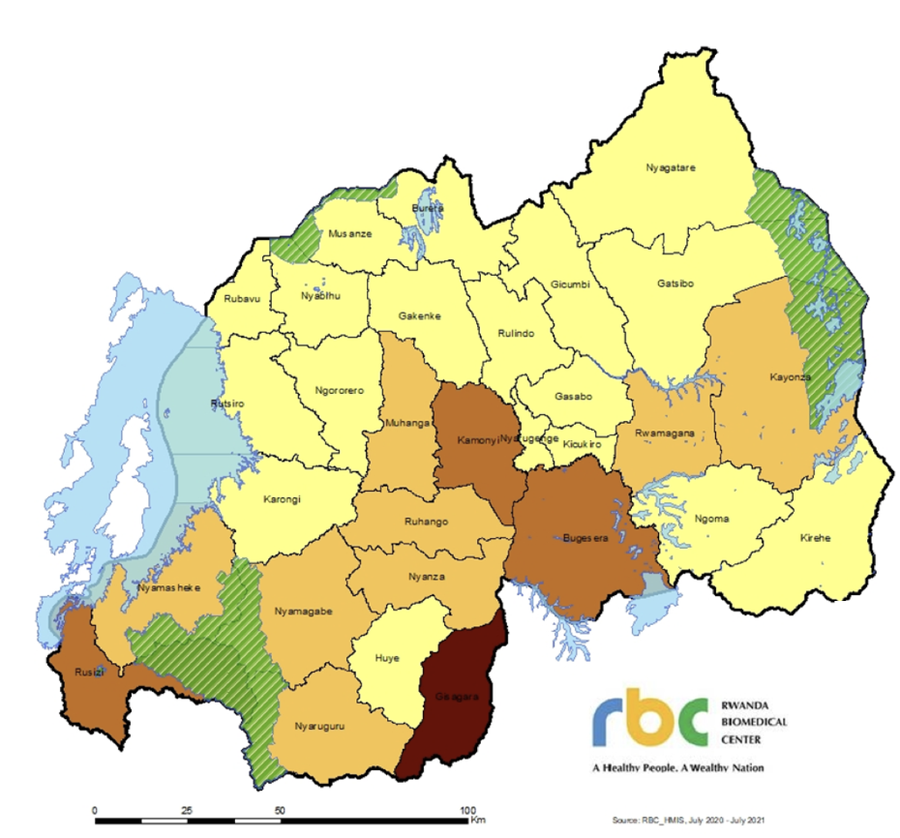
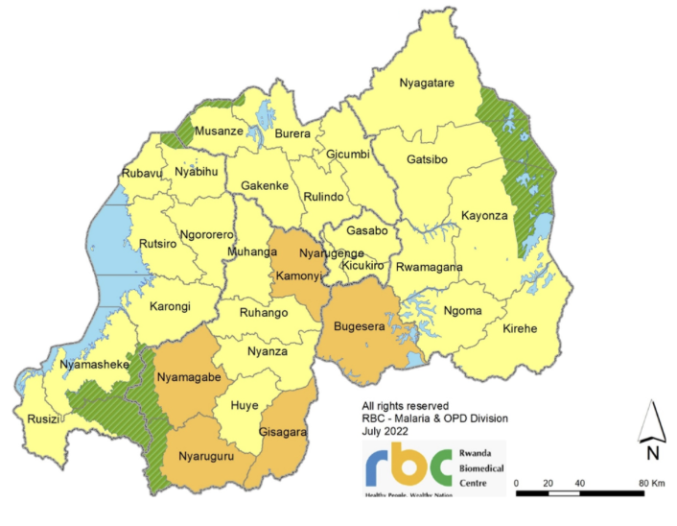
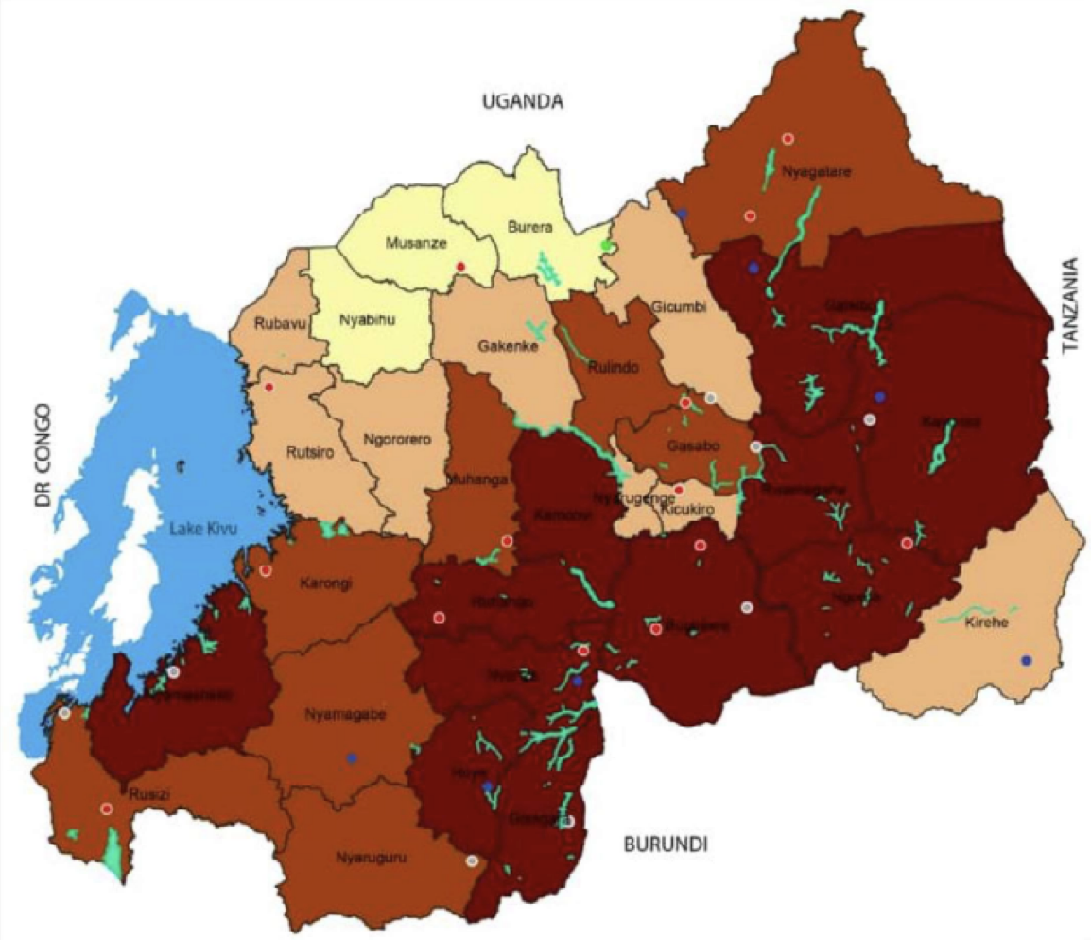
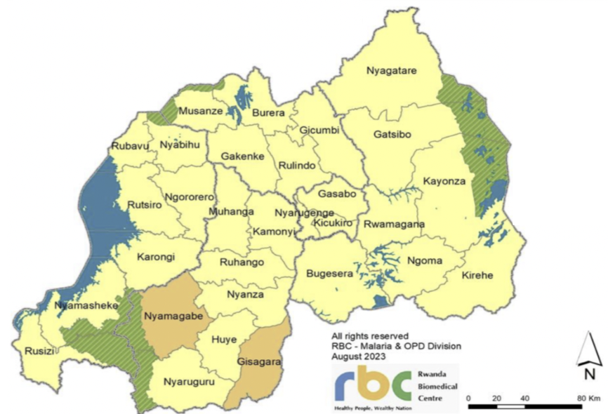
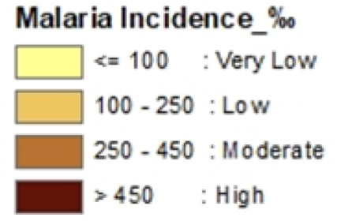
Malaria incidence in Rwanda has been significantly decreasing since 2017
Malaria incidence per 1000 in Rwanda
2016-2017
2020-2021
2021-2022
2022-2023
High geographical and epidemiological heterogeneity

Slide 5

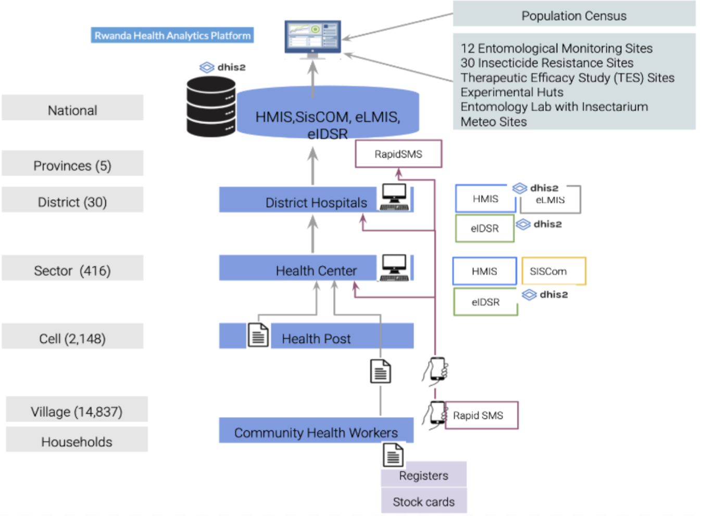
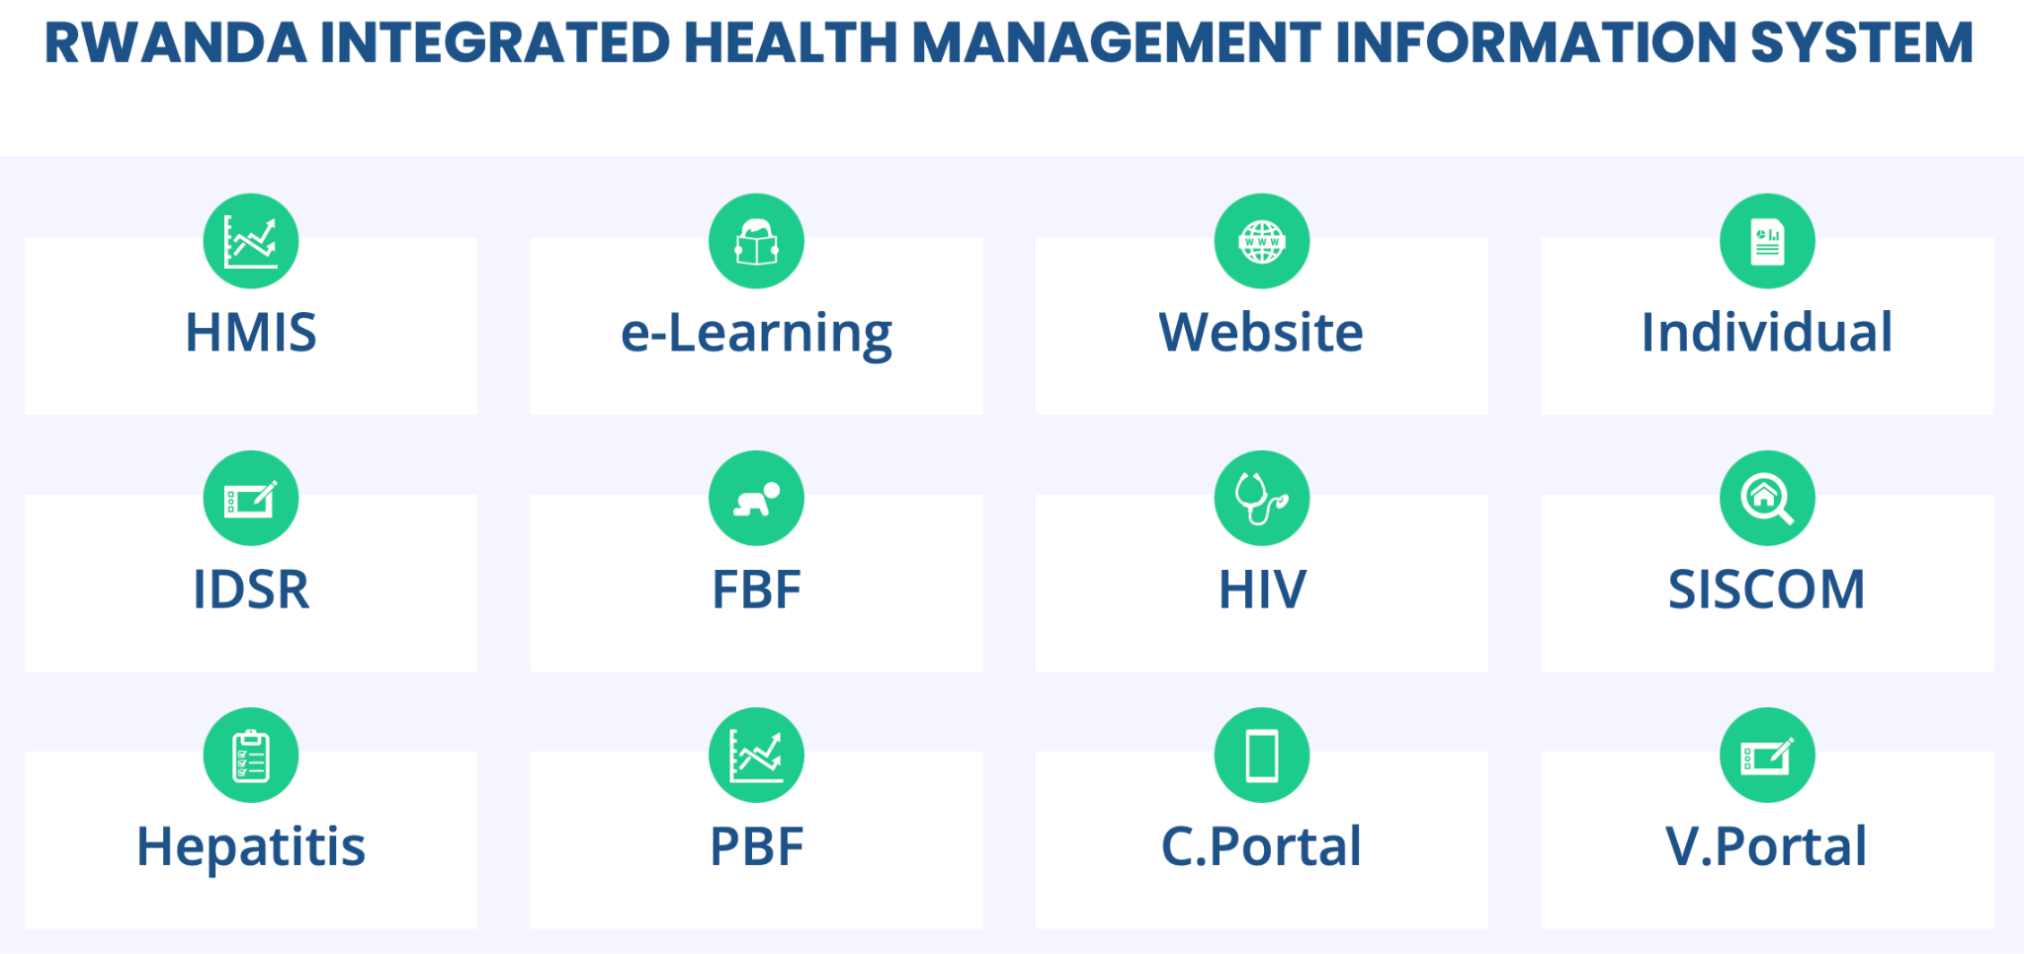
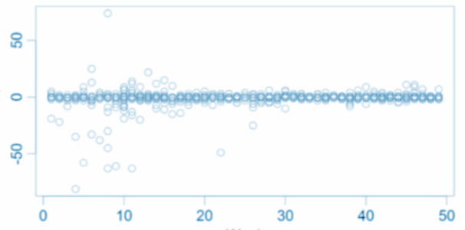
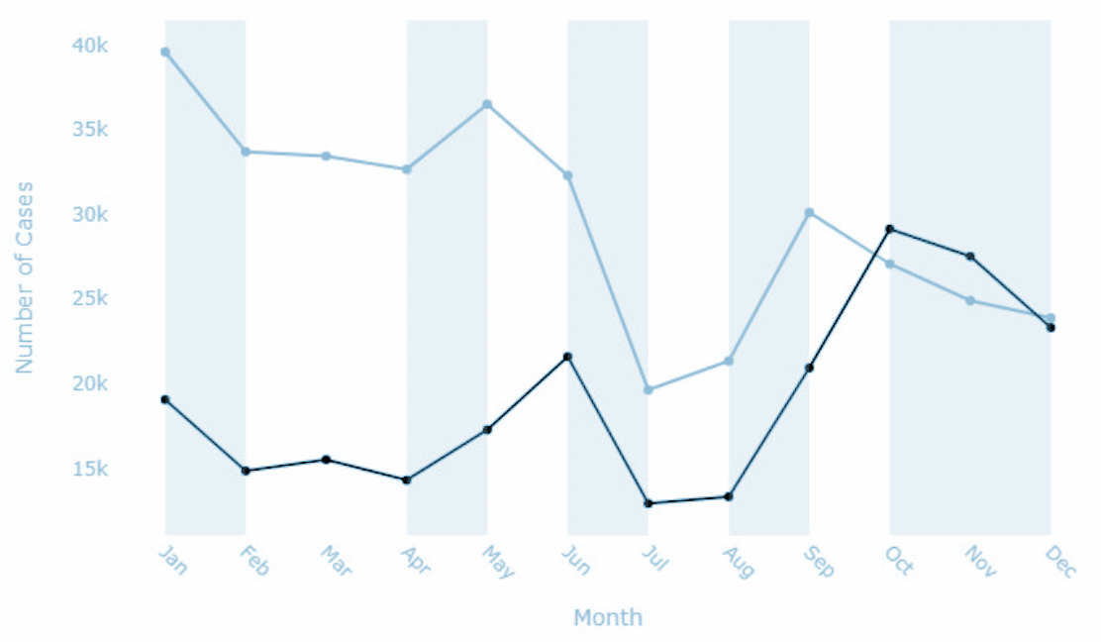
Research objectives
Objective 1: Malaria surveillance assessment and time series analysis
Objective 2: Malaria transmission risk stratification
Objective 3: Using routine data and mathematical modelling to optimize allocation of interventions
Malaria surveillance overview
Mapping information systems and data flow
Data quality indicators
completeness, timeliness, consistency in reporting ; and concordance for metrics captured across different systems
Time series decomposition: trends, seasonality, noise
Descriptive analysis
Key indicators: malaria incidence rates,TPR, contextual factors: general patient attendance, testing rates, HF reporting rates

Slide 6
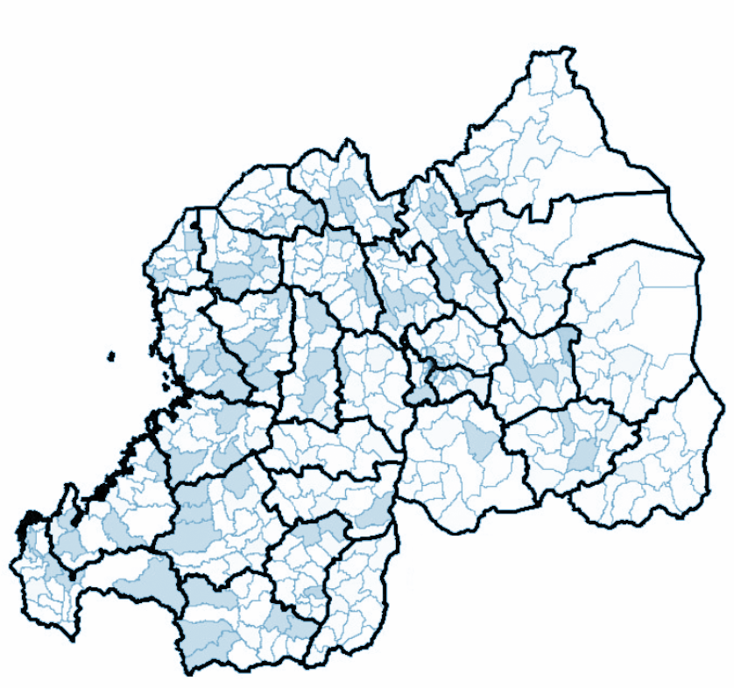
Research objectives
Objective 1: Malaria surveillance assessment and time series analysis
Objective 2: Malaria transmission risk stratification
Objective 3: Using routine data and mathematical modelling to optimize allocation of interventions
Comparing WHO stratification approach and the SwissTPH/AIM methodology used in Tanzania at council and ward levels
Variable selection: API, TPR, PfPR
Principal Component Analysis (PCA)
New risk stratification framework for Rwanda
API = Annual Parasite Incidence
TPR = Test Positivity Rate
PfPR = Plasmodium falciparum Parasite Rate

Slide 7
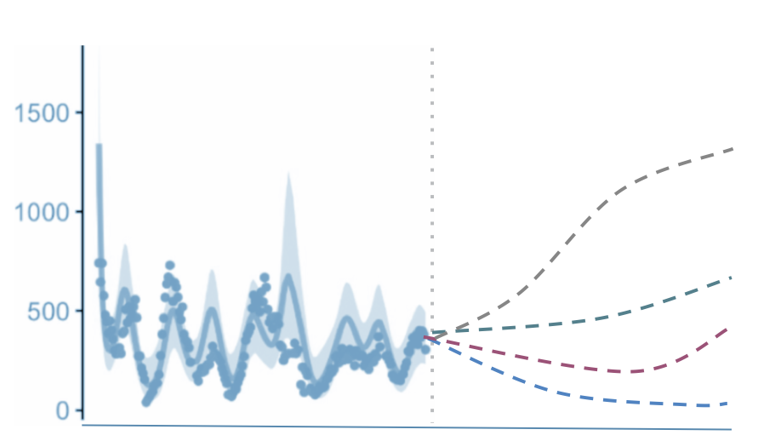
Research objectives
Objective 1: Malaria surveillance assessment and time series analysis
Objective 2: Malaria transmission risk stratification
Objective 3: Using routine data and mathematical modelling to optimize allocation of interventions
Existing climate-driven transmission model (Ukawuba et al, 2022) calibrated on malaria incidence data from 2016 to 2019 in Rwanda
Intervention allocation scenarios

Slide 8
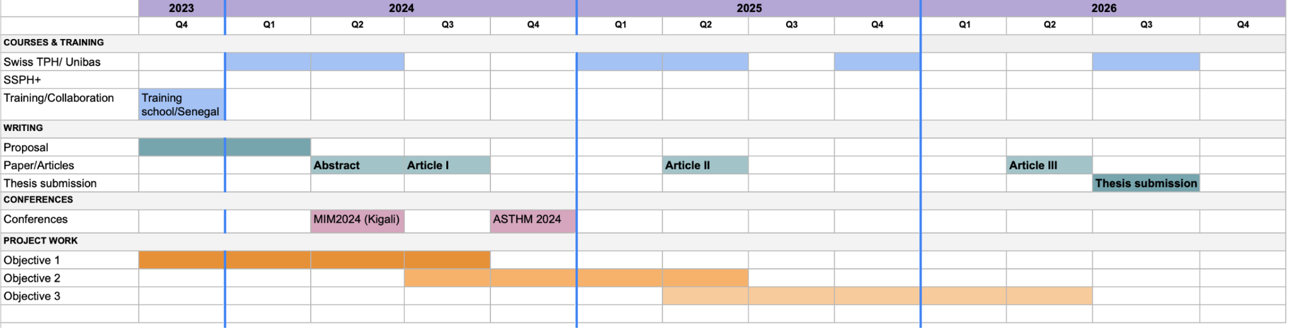
Research timeline

Slide 9
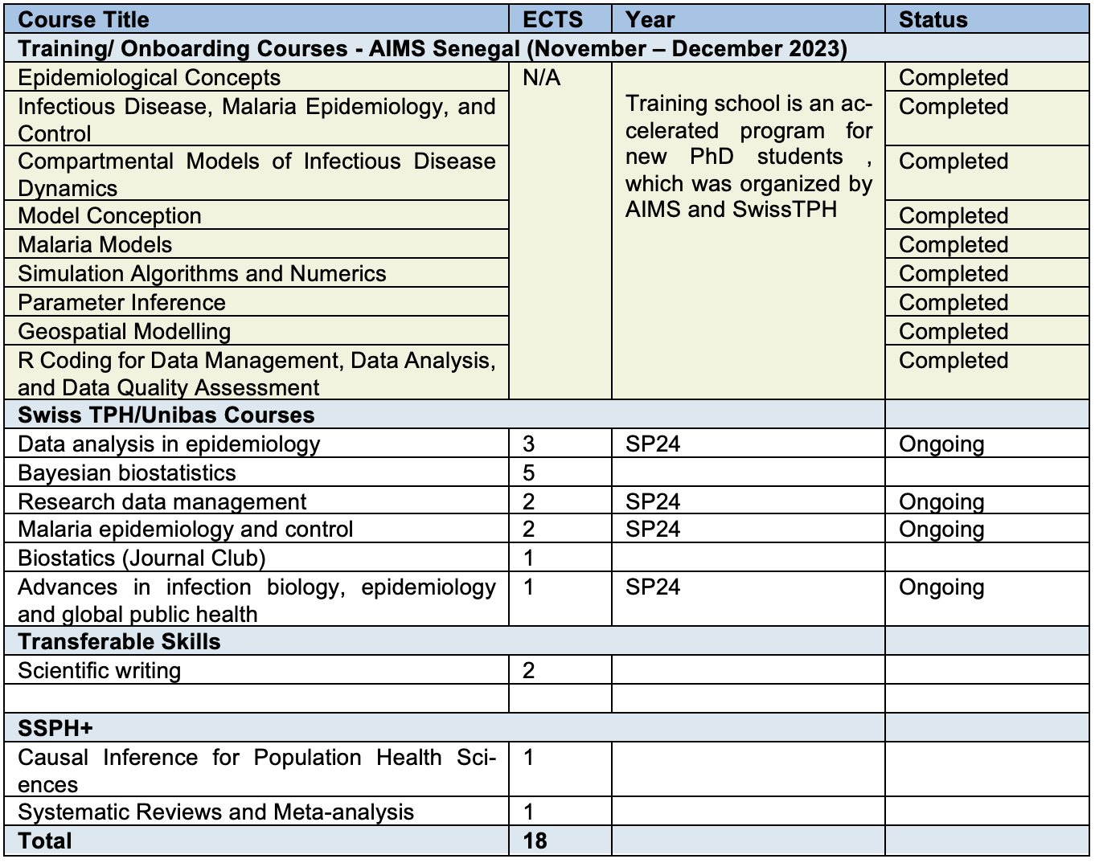
Training plan

Slide 10



THANK YOU FOR YOUR ATTENTION!
MURAKOZE!

